Slide 1

Computer Organization And Architecture
CSE-209
Lecture - 02
Al Bashir
Lecturer, Dept. of CSE
Dhaka International University

Slide 2
ENIAC
ENIAC The ENIAC (Electronic Numerical Integrator And Computer), designed and constructed at the University of Pennsylvania, was the world’s first general purpose electronic digital computer. The project was a response to U.S. needs during
World War II.

Slide 3
ENIAC Cont.…
The Army’s Ballistics Research Laboratory (BRL), an agency responsible for developing range and trajectory tables for new weapons, was having difficulty supplying these tables accurately and within a reasonable time frame. Without these firing tables, the new weapons and artillery were useless to gunners. The BRL employed more than 200 people who, using desktop calculators, solved the necessary ballistics equations. Preparation of the tables for a single weapon would take one person many hours, even days.

Slide 4
ENIAC - background
Electronic Numerical Integrator And Computer
Eckert and Mauchly
University of Pennsylvania
Trajectory tables for weapons
Started 1943
Finished 1946
Too late for war effort
Used until 1955

Slide 5
ENIAC - details
Decimal (not binary)
20 accumulators of 10 digits
Programmed manually by switches
18,000 vacuum tubes
30 tons
15,000 square feet
140 kW power consumption
5,000 additions per second

Slide 6
von Neumann/Turing (IAS Computer)
In 1946, von Neumann and his colleagues began the design of a new stored program computer, referred to as the IAS computer, at the Princeton Institute for Advanced Studies. The IAS computer, although not completed until 1952, is the prototype of all subsequent general-purpose computers.

Slide 7
von Neumann/Turing
Stored Program concept
Main memory storing programs and data
ALU operating on binary data
Control unit interpreting instructions from memory and executing
Input and output equipment operated by control unit
Princeton Institute for Advanced Studies
IAS
Completed 1952

Slide 8
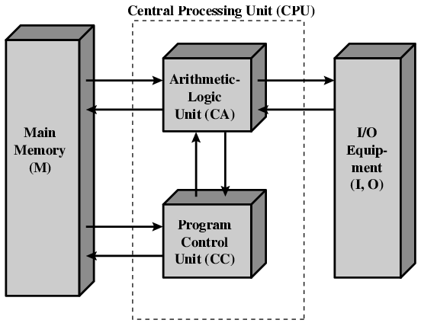
Structure of von Neumann machine

Slide 9
IAS - details
1000 x 40 bit words
Binary number
2 x 20 bit instructions
Set of registers (storage in CPU)
Memory Buffer Register
Memory Address Register
Instruction Register
Instruction Buffer Register
Program Counter
Accumulator
Multiplier Quotient

Slide 10
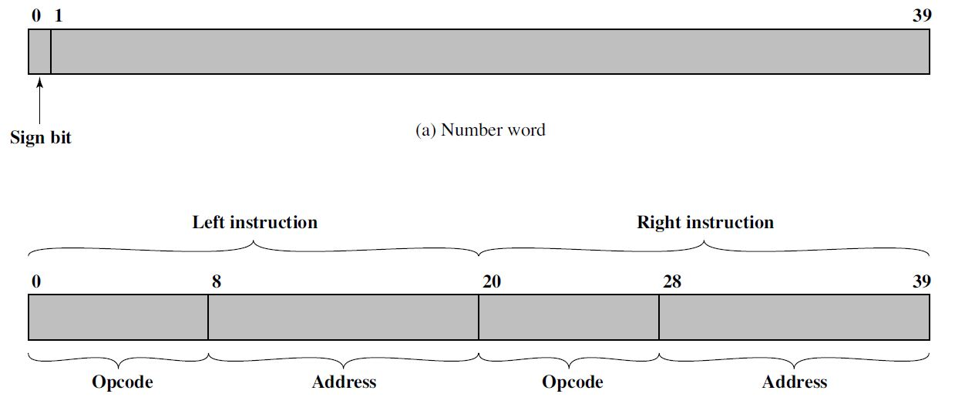
IAS – Memory Format

Slide 11
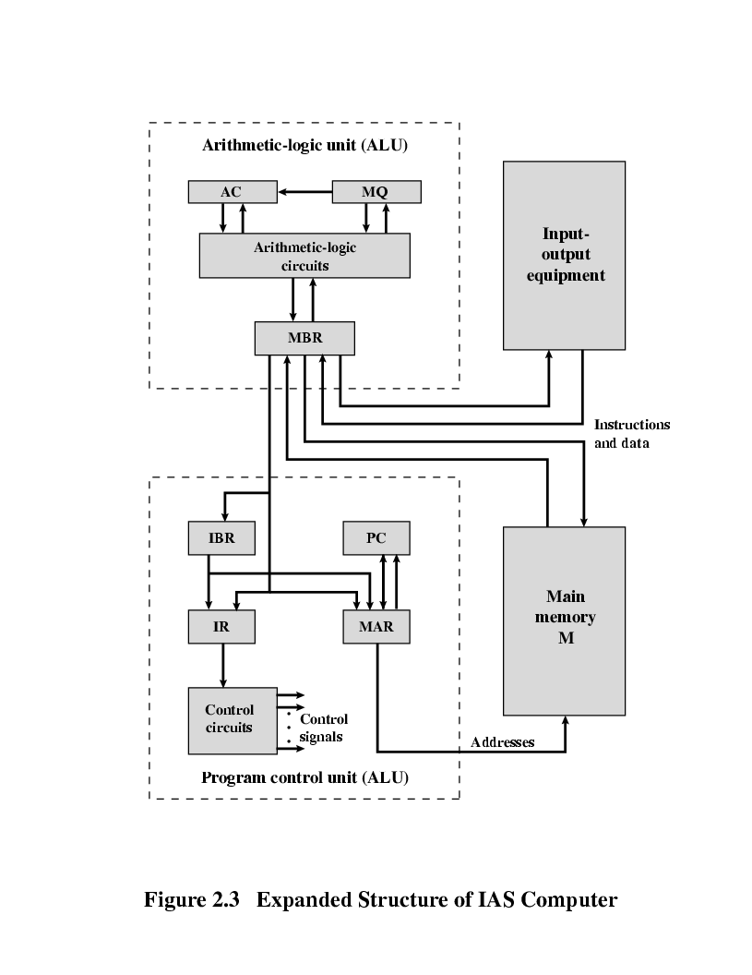
Structure of IAS – detail

Slide 12
Structure of IAS – detail
• Memory buffer register (MBR): Contains a word to be stored in memory or sent to the I/O unit, or is used to receive a word from memory or from the I/O unit.
• Memory address register (MAR): Specifies the address in memory of the word to be written from or read into the MBR.
• Instruction register (IR): Contains the 8-bit opcode instruction being executed.

Slide 13
Structure of IAS – detail
•Instruction buffer register (IBR): Employed to hold temporarily the righthand instruction from a word in memory.
• Program counter (PC): Contains the address of the next instruction-pair to be fetched from memory.
• Accumulator (AC) and multiplier quotient (MQ):Employed to hold temporarily operands and results of ALU operations. For example, the result of multiplying two 40-bit numbers is an 80-bit number; the most significant 40 bits are stored in the AC and the least significant in the MQ.

Slide 14
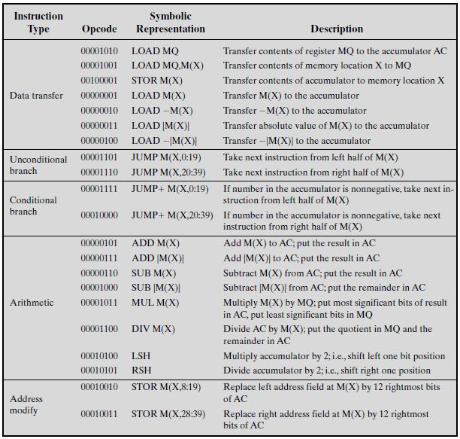
IAS – Instruction Set

Slide 15
Commercial Computers
1947 - Eckert-Mauchly Computer Corporation
UNIVAC I (Universal Automatic Computer)
US Bureau of Census 1950 calculations
Became part of Sperry-Rand Corporation
Late 1950s - UNIVAC II
Faster
More memory

Slide 16
IBM
Punched-card processing equipment
1953 - the 701
IBM’s first stored program computer
Scientific calculations
1955 - the 702
Business applications
Lead to 700/7000 series

Slide 17
Transistors
Replaced vacuum tubes
Smaller
Cheaper
Less heat dissipation
Solid State device
Made from Silicon (Sand)
Invented 1947 at Bell Labs
William Shockley et al.

Slide 18
Transistor Based Computers
Second generation machines
NCR & RCA produced small transistor machines
IBM 7000
DEC - 1957
Produced PDP-1

Slide 19
Microelectronics
Literally - “small electronics”
A computer is made up of gates, memory cells and interconnections
These can be manufactured on a semiconductor
e.g. silicon wafer

Slide 20
Generations of Computer
Vacuum tube - 1946-1957
Transistor - 1958-1964
Small scale integration - 1965 on
Up to 100 devices on a chip
Medium scale integration - to 1971
100-3,000 devices on a chip
Large scale integration - 1971-1977
3,000 - 100,000 devices on a chip
Very large scale integration - 1978 -1991
100,000 - 100,000,000 devices on a chip
Ultra large scale integration – 1991 -
Over 100,000,000 devices on a chip

Slide 21
Moore’s Law
Increased density of components on chip
Gordon Moore – co-founder of Intel
Number of transistors on a chip will double every year
Since 1970’s development has slowed a little
Number of transistors doubles every 18 months
Cost of a chip has remained almost unchanged
Higher packing density means shorter electrical paths, giving higher performance
Smaller size gives increased flexibility
Reduced power and cooling requirements
Fewer interconnections increases reliability

Slide 22
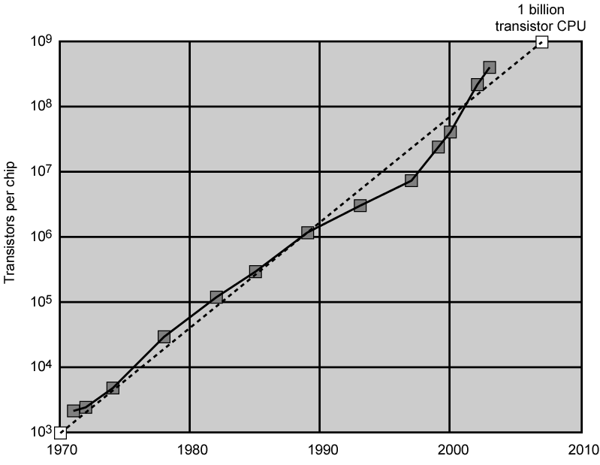
Growth in CPU Transistor Count

Slide 23
IBM 360 series
1964
Replaced (& not compatible with) 7000 series
First planned “family” of computers
Similar or identical instruction sets
Similar or identical O/S
Increasing speed
Increasing number of I/O ports (i.e. more terminals)
Increased memory size
Increased cost
Multiplexed switch structure

Slide 24
DEC PDP-8
1964
First minicomputer (after miniskirt!)
Did not need air conditioned room
Small enough to sit on a lab bench
$16,000
$100k+ for IBM 360
Embedded applications & OEM
BUS STRUCTURE

Slide 25
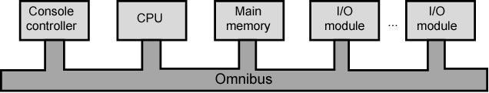
DEC - PDP-8 Bus Structure

Slide 26
Semiconductor Memory
1970
Fairchild
Size of a single core
i.e. 1 bit of magnetic core storage
Holds 256 bits
Non-destructive read
Much faster than core
Capacity approximately doubles each year

Slide 27
Intel
1971 - 4004
First microprocessor
All CPU components on a single chip
4 bit
Followed in 1972 by 8008
8 bit
Both designed for specific applications
1974 - 8080
Intel’s first general purpose microprocessor

Slide 28
Speeding it up
Pipelining
On board cache
On board L1 & L2 cache
Branch prediction
Data flow analysis
Speculative execution

Slide 29
Performance Balance
Processor speed increased
Memory capacity increased
Memory speed lags behind processor speed

Slide 30
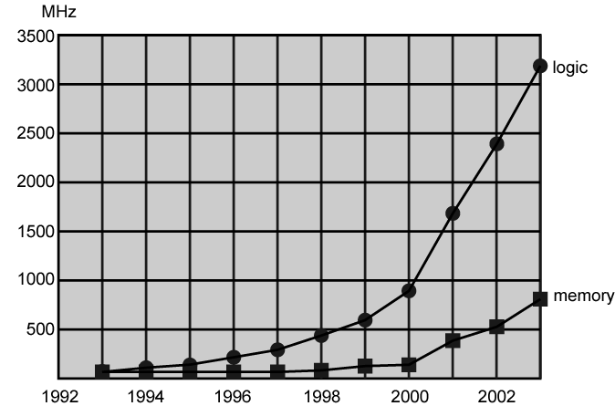
Login and Memory Performance Gap

Slide 31
Solutions
Increase number of bits retrieved at one time
Make DRAM “wider” rather than “deeper”
Change DRAM interface
Cache
Reduce frequency of memory access
More complex cache and cache on chip
Increase interconnection bandwidth
High speed buses
Hierarchy of buses

Slide 32
I/O Devices
Peripherals with intensive I/O demands
Large data throughput demands
Processors can handle this
Problem moving data
Solutions:
Caching
Buffering
Higher-speed interconnection buses
More elaborate bus structures
Multiple-processor configurations

Slide 33
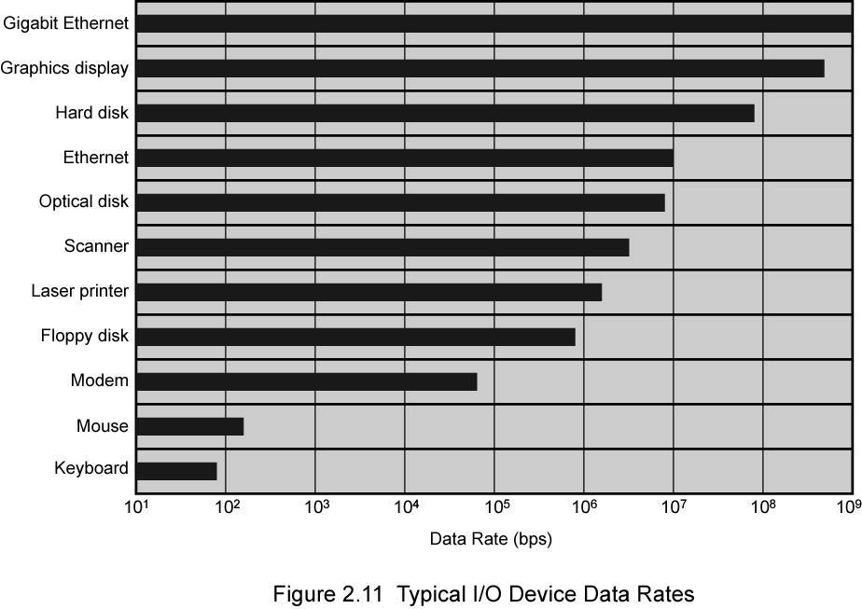
Typical I/O Device Data Rates

Slide 34
Key is Balance
Processor components
Main memory
I/O devices
Interconnection structures

Slide 35
Improvements in Chip Organization and Architecture
Increase hardware speed of processor
Fundamentally due to shrinking logic gate size
More gates, packed more tightly, increasing clock rate
Propagation time for signals reduced
Increase size and speed of caches
Dedicating part of processor chip
Cache access times drop significantly
Change processor organization and architecture
Increase effective speed of execution
Parallelism

Slide 36
Problems with Clock Speed and Login Density
Power
Power density increases with density of logic and clock speed
Dissipating heat
RC delay
Speed at which electrons flow limited by resistance and capacitance of metal wires connecting them
Delay increases as RC product increases
Wire interconnects thinner, increasing resistance
Wires closer together, increasing capacitance
Memory latency
Memory speeds lag processor speeds
Solution:
More emphasis on organizational and architectural approaches

Slide 37
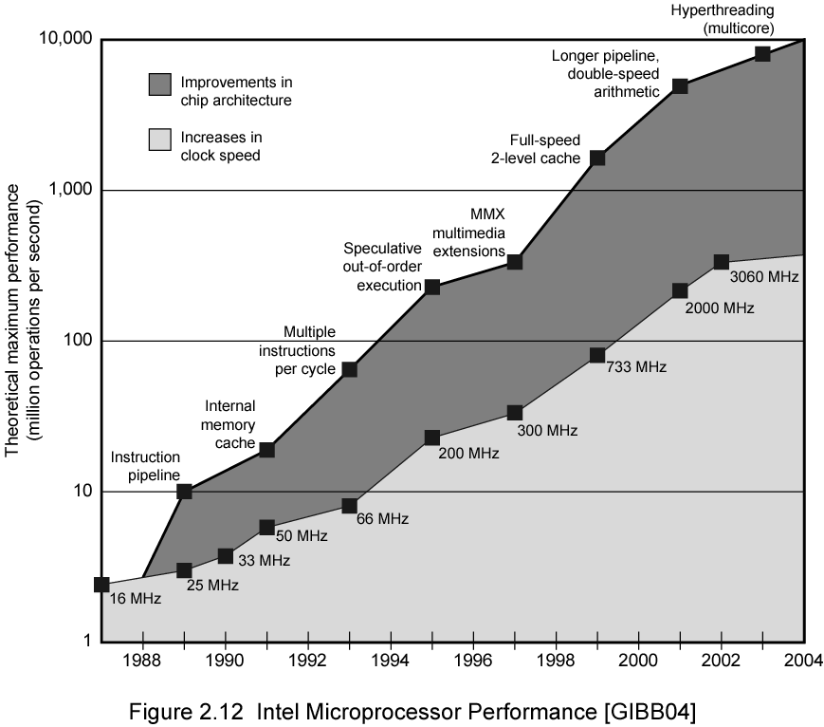
Intel Microprocessor Performance

Slide 38
Increased Cache Capacity
Typically two or three levels of cache between processor and main memory
Chip density increased
More cache memory on chip
Faster cache access
Pentium chip devoted about 10% of chip area to cache
Pentium 4 devotes about 50%

Slide 39
More Complex Execution Logic
Enable parallel execution of instructions
Pipeline works like assembly line
Different stages of execution of different instructions at same time along pipeline
Superscalar allows multiple pipelines within single processor
Instructions that do not depend on one another can be executed in parallel

Slide 40
Diminishing Returns
Internal organization of processors complex
Can get a great deal of parallelism
Further significant increases likely to be relatively modest
Benefits from cache are reaching limit
Increasing clock rate runs into power dissipation problem
Some fundamental physical limits are being reached

Slide 41
New Approach – Multiple Cores
Multiple processors on single chip
Large shared cache
Within a processor, increase in performance proportional to square root of increase in complexity
If software can use multiple processors, doubling number of processors almost doubles performance
So, use two simpler processors on the chip rather than one more complex processor
With two processors, larger caches are justified
Power consumption of memory logic less than processing logic

Slide 42
x86 Evolution (1)
8080
first general purpose microprocessor
8 bit data path
Used in first personal computer – Altair
8086 – 5MHz – 29,000 transistors
much more powerful
16 bit
instruction cache, prefetch few instructions
8088 (8 bit external bus) used in first IBM PC
80286
16 Mbyte memory addressable
up from 1Mb
80386
32 bit
Support for multitasking
80486
sophisticated powerful cache and instruction pipelining
built in maths co-processor

Slide 43
x86 Evolution (2)
Pentium
Superscalar
Multiple instructions executed in parallel
Pentium Pro
Increased superscalar organization
Aggressive register renaming
branch prediction
data flow analysis
speculative execution
Pentium II
MMX technology
graphics, video & audio processing
Pentium III
Additional floating point instructions for 3D graphics

Slide 44
x86 Evolution (3)
Pentium 4
Note Arabic rather than Roman numerals
Further floating point and multimedia enhancements
Core
First x86 with dual core
Core 2
64 bit architecture
Core 2 Quad – 3GHz – 820 million transistors
Four processors on chip
x86 architecture dominant outside embedded systems
Organization and technology changed dramatically
Instruction set architecture evolved with backwards compatibility
~1 instruction per month added
500 instructions available
See Intel web pages for detailed information on processors

Slide 45
Embedded Systems ARM
ARM evolved from RISC design
Used mainly in embedded systems
Used within product
Not general purpose computer
Dedicated function
E.g. Anti-lock brakes in car

Slide 46
Embedded Systems Requirements
Different sizes
Different constraints, optimization, reuse
Different requirements
Safety, reliability, real-time, flexibility, legislation
Lifespan
Environmental conditions
Static v dynamic loads
Slow to fast speeds
Computation v I/O intensive
Descrete event v continuous dynamics

Slide 47
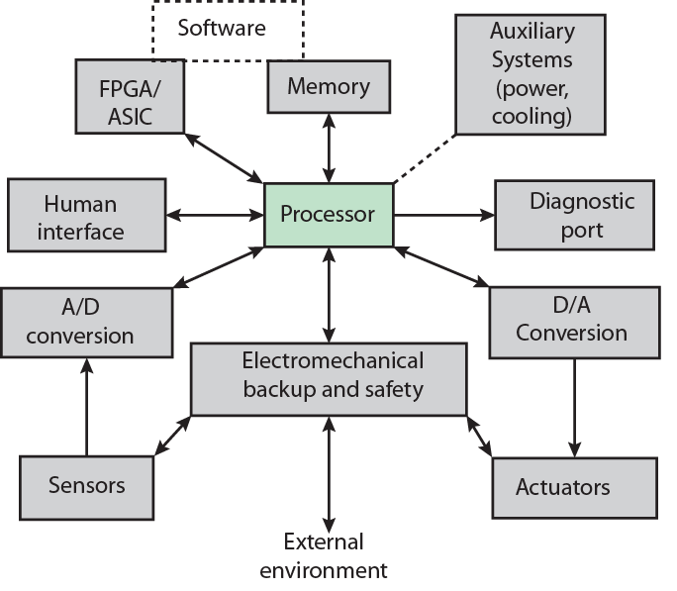
Possible Organization of an Embedded System

Slide 48
ARM Evolution
Designed by ARM Inc., Cambridge, England
Licensed to manufacturers
High speed, small die, low power consumption
PDAs, hand held games, phones
E.g. iPod, iPhone
Acorn produced ARM1 & ARM2 in 1985 and ARM3 in 1989
Acorn, VLSI and Apple Computer founded ARM Ltd.

Slide 49
ARM Systems Categories
Embedded real time
Application platform
Linux, Palm OS, Symbian OS, Windows mobile
Secure applications

Slide 50
Performance Assessment Clock Speed
Key parameters
Performance, cost, size, security, reliability, power consumption
System clock speed
In Hz or multiples of
Clock rate, clock cycle, clock tick, cycle time
Signals in CPU take time to settle down to 1 or 0
Signals may change at different speeds
Operations need to be synchronised
Instruction execution in discrete steps
Fetch, decode, load and store, arithmetic or logical
Usually require multiple clock cycles per instruction
Pipelining gives simultaneous execution of instructions
So, clock speed is not the whole story

Slide 51
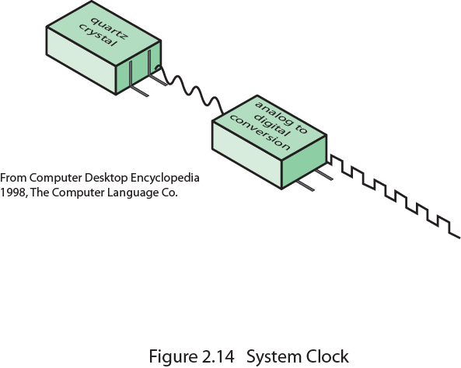
System Clock

Slide 52
Instruction Execution Rate
Millions of instructions per second (MIPS)
Millions of floating point instructions per second (MFLOPS)
Heavily dependent on instruction set, compiler design, processor implementation, cache & memory hierarchy

Slide 53
Benchmarks
Programs designed to test performance
Written in high level language
Portable
Represents style of task
Systems, numerical, commercial
Easily measured
Widely distributed
E.g. System Performance Evaluation Corporation (SPEC)
CPU2006 for computation bound
17 floating point programs in C, C++, Fortran
12 integer programs in C, C++
3 million lines of code
Speed and rate metrics
Single task and throughput

Slide 54

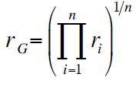
SPEC Speed Metric
Single task
Base runtime defined for each benchmark using reference machine
Results are reported as ratio of reference time to system run time
Tref_{i} execution time for benchmark i on reference machine
Tsut_{i} execution time of benchmark i on test system
Overall performance calculated by averaging ratios for all 12 integer benchmarks
Use geometric mean
Appropriate for normalized numbers such as ratios

Slide 55
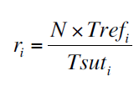
SPEC Rate Metric
Measures throughput or rate of a machine carrying out a number of tasks
Multiple copies of benchmarks run simultaneously
Typically, same as number of processors
Ratio is calculated as follows:
Tref_{i} reference execution time for benchmark i
N number of copies run simultaneously
Tsuti elapsed time from start of execution of program on all N processors until completion of all copies of program
Again, a geometric mean is calculated

Slide 56
Amdahl’s Law
Gene Amdahl [AMDA67]
Potential speed up of program using multiple processors
Concluded that:
Code needs to be parallelizable
Speed up is bound, giving diminishing returns for more processors
Task dependent
Servers gain by maintaining multiple connections on multiple processors
Databases can be split into parallel tasks

Slide 57
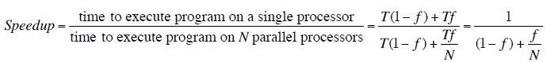
Amdahl’s Law Formula
For program running on single processor
Fraction f of code infinitely parallelizable with no scheduling overhead
Fraction (1-f) of code inherently serial
T is total execution time for program on single processor
N is number of processors that fully exploit parralle portions of code
Conclusions
f small, parallel processors has little effect
N ->∞, speedup bound by 1/(1 – f)
Diminishing returns for using more processors

Slide 58
Internet Resources
http://www.intel.com/
Search for the Intel Museum
http://www.ibm.com
http://www.dec.com
Charles Babbage Institute
PowerPC
Intel Developer Home

Slide 59
References
AMDA67 Amdahl, G. “Validity of the Single-Processor Approach to Achieving Large-Scale Computing Capability”, Proceedings of the AFIPS Conference, 1967.

Slide 60
Question??

Slide 61
Thanks

